Slide 1
NAME: MADHURSHAN J DEPT: B.TECH(AI&DS) REGISTER NO: 821721243033 COLLEGE NAME: SIR ISSAC NEWTON COLLEGE OF ENGINEERING AND TECHNOLOGY
FINAL PROJECT
3/21/2024 Annual Review

Slide 2

Medical Insurance Price Prediction
3/21/2024 Annual Review

Slide 3


AGENDA
Medical Price Prediction Agenda
Data Collection and Preparation
Feature Selection and Engineering
Model Selection
Model Training and Evaluation
Model Interpretation
Challenges and Limitations
Ethical Considerations
Future Directions
Conclusion
3/21/2024 Annual Review

Slide 4

PROBLEM STATEMENT
The problem at hand is to develop a robust and accurate medical price prediction model that can forecast the costs associated with healthcare services, procedures, and treatments. This predictive model aims to address the following key objectives:
Cost Transparency: Enhance transparency in healthcare pricing by providing patients and healthcare providers with reliable estimates of medical expenses prior to treatment.
Financial Planning: Enable individuals and families to plan and budget for healthcare costs more effectively, reducing the financial burden associated with unexpected medical bills.
Resource Allocation: Assist policymakers, insurers, and healthcare organizations in allocating resources efficiently by predicting future healthcare expenditures and identifying areas for cost containment.
Equity and Accessibility: Promote equity in healthcare access by empowering patients to make informed decisions based on anticipated costs, thereby reducing barriers to essential healthcare services.
3/21/2024 Annual Review

Slide 5

PROJECT OVERVIEW
In today's healthcare landscape, the opacity surrounding medical pricing often leads to unforeseen financial burdens for patients and inefficiencies in resource allocation within healthcare systems. This project seeks to mitigate these challenges by developing a sophisticated predictive model capable of accurately estimating medical prices.
Through meticulous data collection, preprocessing, and feature engineering, the project will lay the groundwork for building robust predictive models. These models will not only provide patients with transparent estimates of medical expenses but also enable healthcare providers, insurers, and policymakers to optimize resource allocation, streamline budgeting processes, and improve overall healthcare affordability and accessibility.
3/21/2024 Annual Review

Slide 6

WHO ARE THE END USERS?
Patients and Healthcare Consumers: Patients are one of the primary end users of medical price prediction models.
Healthcare Providers: Healthcare providers, including hospitals, clinics, and individual practitioners, can benefit from medical price prediction by offering transparent pricing information to patients.
Health Insurance Companies: Insurance companies can leverage medical price prediction models to estimate future healthcare expenditures, set insurance premiums, and develop more accurate cost-sharing mechanisms with policyholders.
Policymakers and Government Agencies: Policymakers and government agencies responsible for healthcare regulation and public health initiatives can use medical price prediction models to inform policy decisions, allocate healthcare resources effectively, and address disparities in healthcare access and affordability.
Healthcare Administrators and Finance Departments: Healthcare administrators and finance departments within healthcare organizations can employ medical price prediction models to forecast revenue streams, optimize pricing strategies, and manage financial risks associated with healthcare service delivery
3/21/2024 Annual Review

Slide 7
YOUR SOLUTION AND ITS VALUE PROPOSITION
Solution: The proposed solution for medical price prediction involves the development and deployment of a sophisticated predictive model leveraging machine learning algorithms and comprehensive healthcare datasets. This model aims to accurately estimate medical expenses for various healthcare services, procedures, and treatments.
Key Components of the Solution
Data Integration and Preprocessing
Feature Engineering
Model Development
Evaluation and Validation
Deployment and Integration
Value Proposition
Transparency and Informed Decision-Making: The predictive model enhances transparency in healthcare pricing by providing patients and healthcare providers with accurate estimates of medical expenses upfront
Financial Planning and Budgeting: By predicting medical prices accurately, the solution helps individuals and families plan and budget for healthcare expenses more effectively.
3/21/2024 Annual Review

Slide 8

THE WOW IN YOUR SOLUTION
The "wow" factor in the solution for medical price prediction lies in its ability to revolutionize the healthcare landscape by addressing longstanding challenges and transforming the way medical expenses are estimated and managed. Here's why this solution is truly remarkable
Seamlessly integrates with existing healthcare systems, providing instant access to accurate medical price predictions
Empowers patients with personalized cost estimates, fostering transparency and trust in healthcare decision-making
Utilizes advanced machine learning algorithms to continuously refine and improve prediction accuracy over time
Offers real-time updates on pricing trends, enabling proactive cost management for healthcare providers and insurers
Incorporates patient-specific factors and preferences to deliver tailored pricing information for individualized care
Enables comparative analysis of treatment options based on projected costs, facilitating informed patient-provider discussions
3/21/2024 Annual Review
8

Slide 9
MODELLING
In the modeling phase of medical price prediction, we will explore two simple yet effective approaches: linear regression and decision trees. Linear regression is a classical statistical method that establishes a linear relationship between independent variables (such as patient demographics, diagnosis codes, and treatment types) and the dependent variable (medical price). By fitting a regression line to the data, we can predict medical prices based on the values of the input features. This approach provides interpretable results and is relatively easy to implement.
Additionally, decision trees offer a straightforward and intuitive modeling technique. Decision trees partition the data into subsets based on the values of input features, recursively splitting the data until a certain stopping criterion is met. Each leaf node of the tree represents a predicted medical price. Decision trees are particularly useful for capturing nonlinear relationships and interactions between features. By comparing the performance of these two models, we can gain insights into the predictive power of different modeling approaches and select the one that best suits the characteristics of the medical price prediction problem.
3/21/2024 Annual Review
9

Slide 10
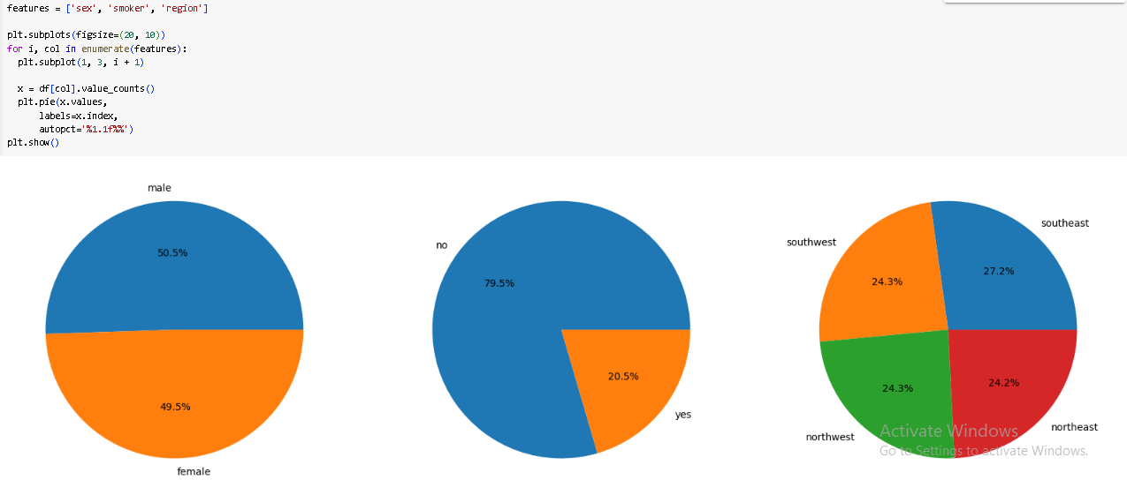
DATA VISUALIZATIOHN

Slide 11
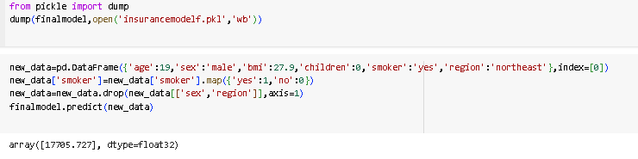
RESULTS
Demo Link
3/21/2024 Annual Review
11

